Slide 1
Building chatbots with MS Bot Framework
Getting Started

Slide 2
Getting started
Visual Studio 2017 - Free Community version or higher
Bot Template for Visual Studio
Bot Framework emulator
Luis.ai account
Botframework account
Microsoft Azure account

Slide 3
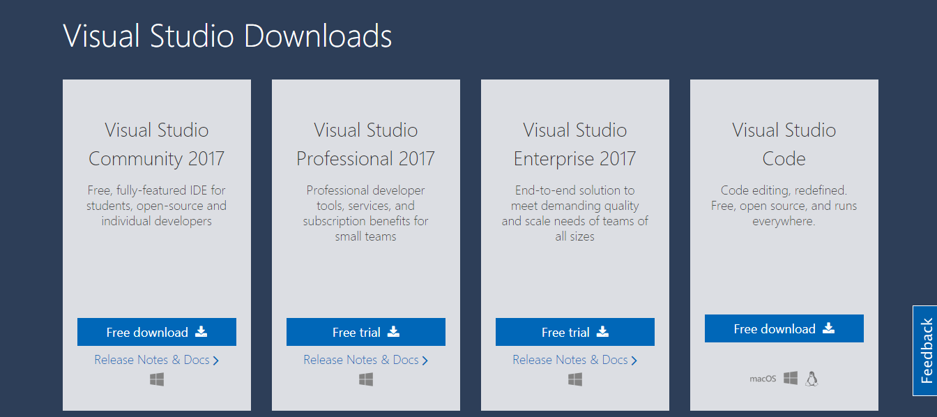
https://www.visualstudio.com/downloads/

Slide 4
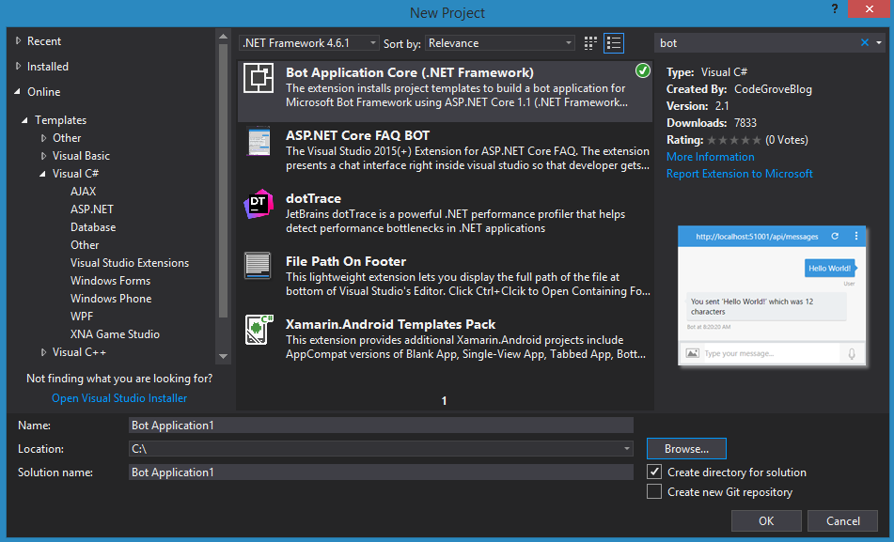
To Install Bot Template for Visual Studio
File-> New Project -> Online -> Templates -> Visual C# -> Search for “bot” -> install “Bot Application Core (.NET Framework)”

Slide 5
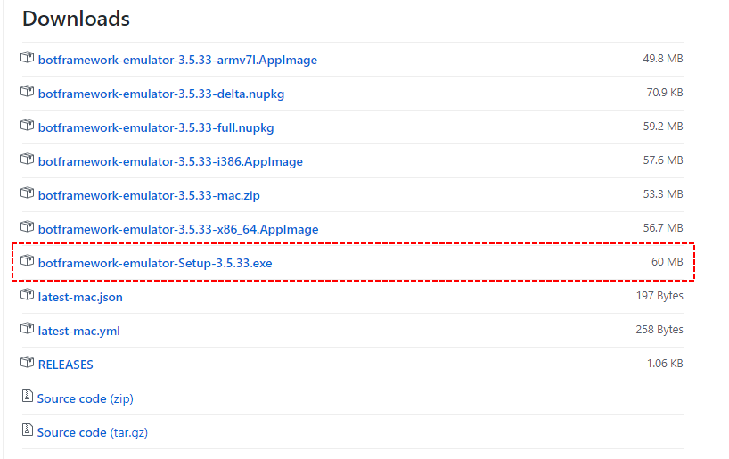
https://emulator.botframework.com/

Slide 6
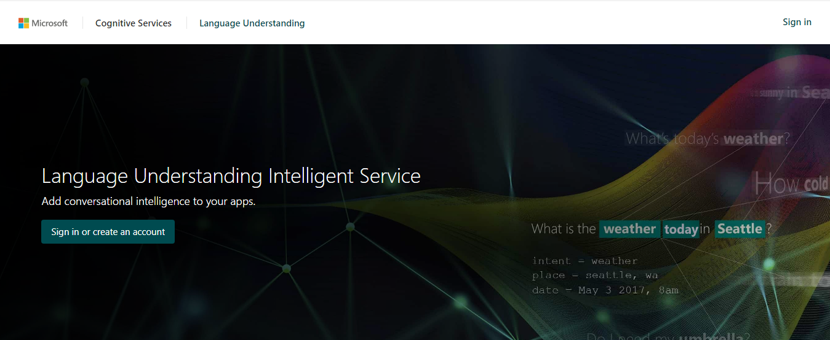
https://www.luis.ai/home

Slide 7
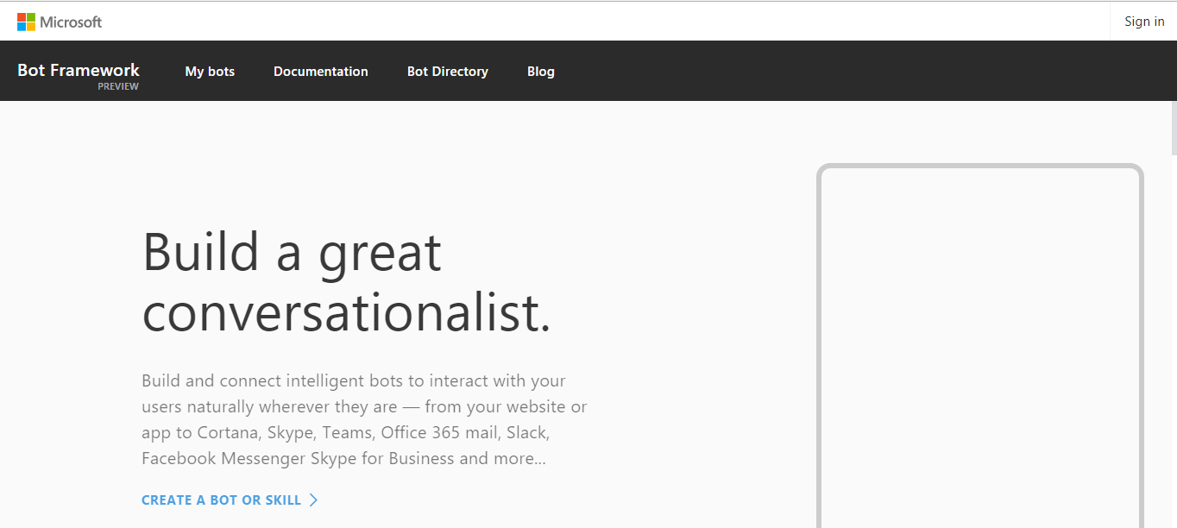
https://dev.botframework.com/

Slide 8
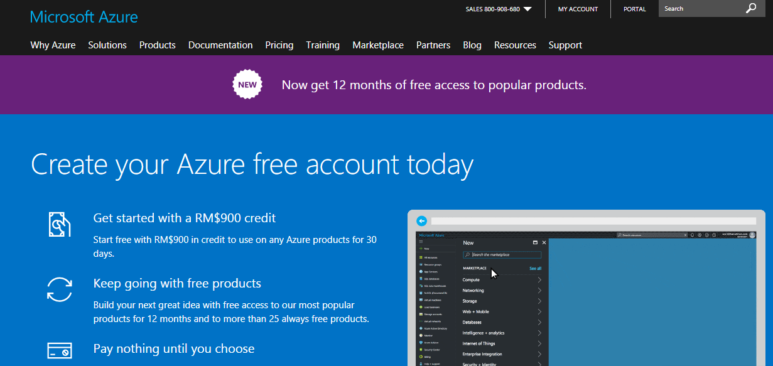
https://azure.microsoft.com/en-us/free/

Slide 9
Create Hello World Bot

Slide 10
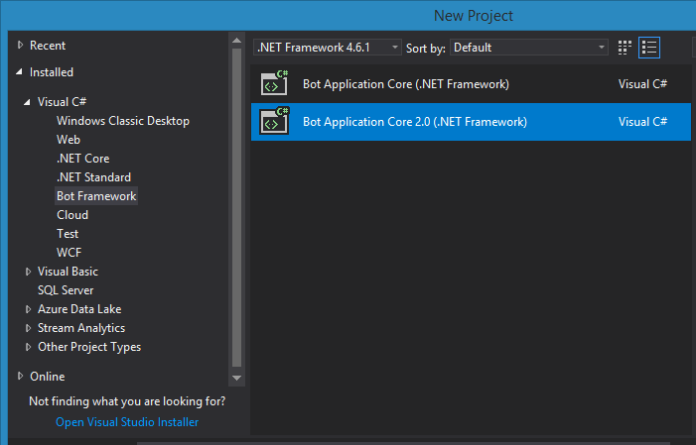
Create new project

Slide 11
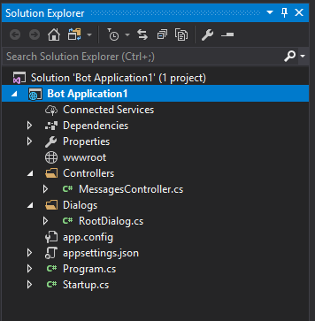
Bot Application 1

Slide 12
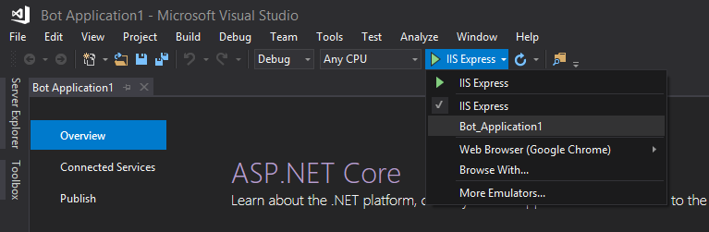
Change Run to Bot_Application1

Slide 13
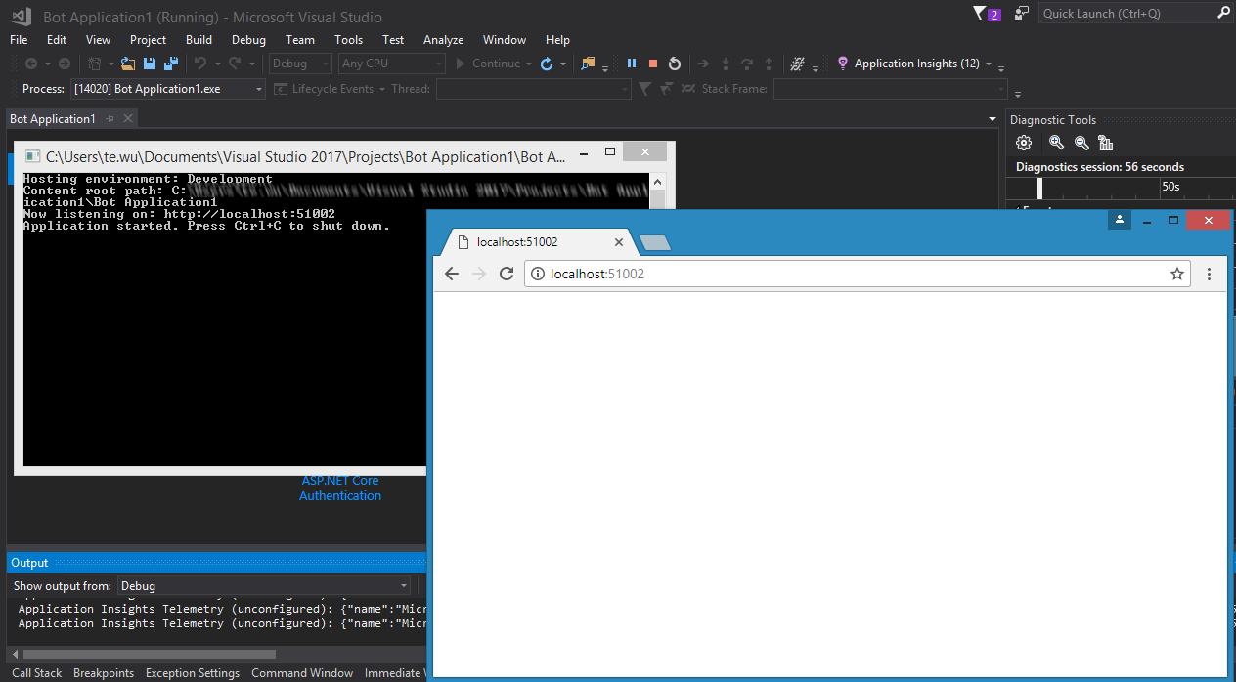
Start the application
Make a note of the app URL

Slide 14
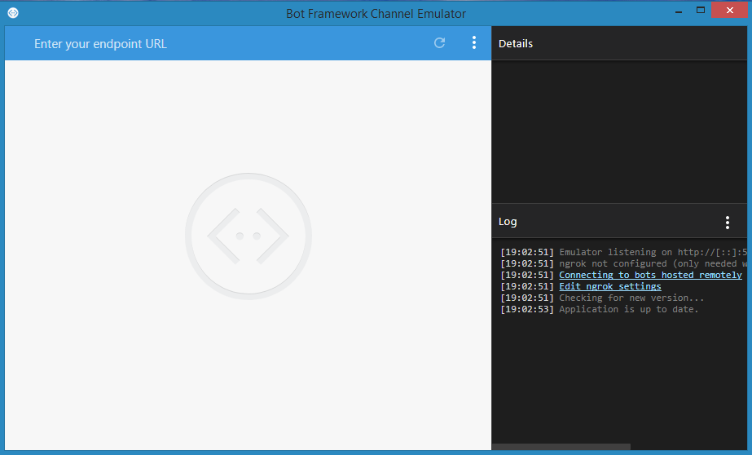
Start Bot Framework Emulator

Slide 15
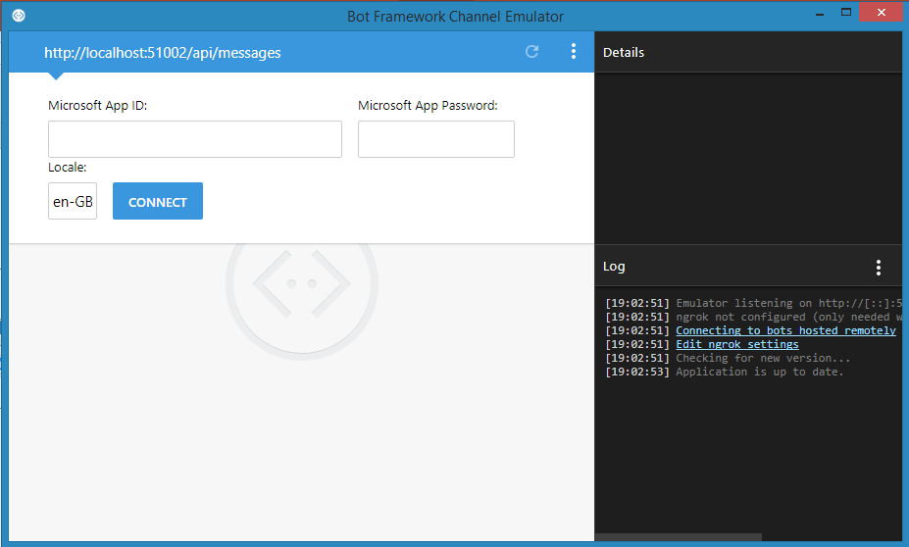
Key in your URL “{bot app url}/api/messages”
Then click connect

Slide 16
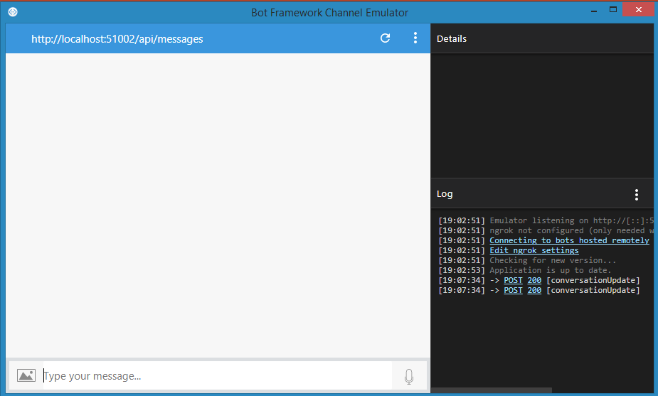
Your should see this

Slide 17
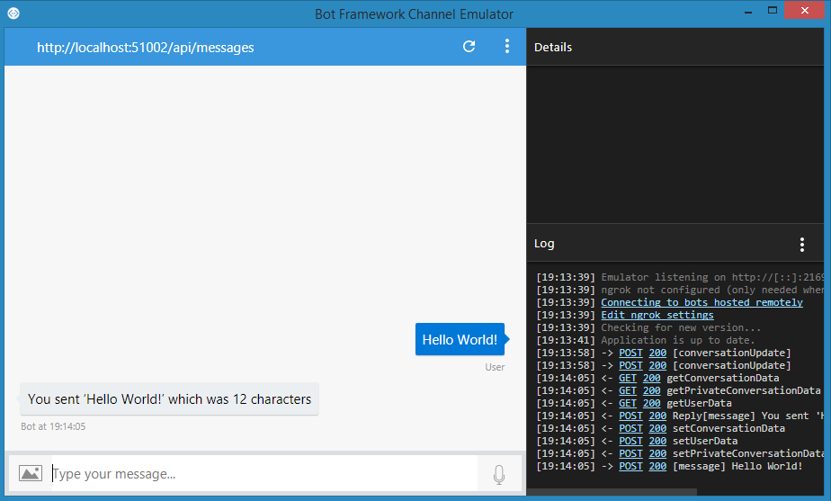
Type “Hello World” and if you see the bot respond.
Congratulations! You’ve just created your first bot
and ready for the next step!

